Slide 1
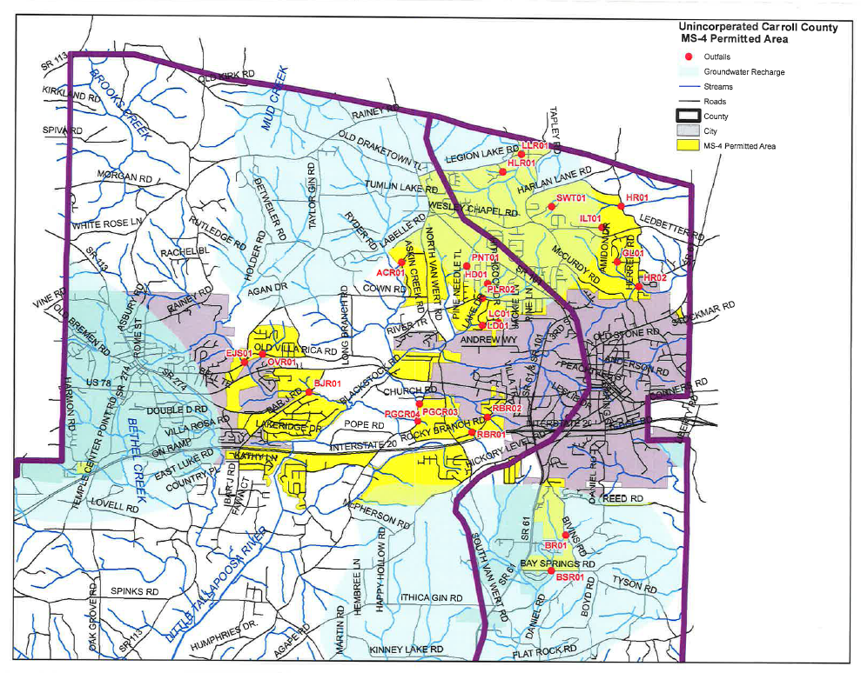
Tallapoosa Watershed
Chattahoochee Watershed

